Slide 1
GREG COLLINS
SEO FOR
SMALL BUSINESS

Slide 2
YOU ARE DOING SEO ALL WRONG
SEO FROM THE START

Slide 3
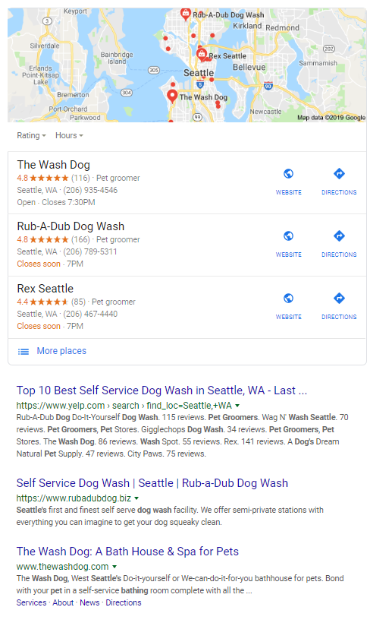
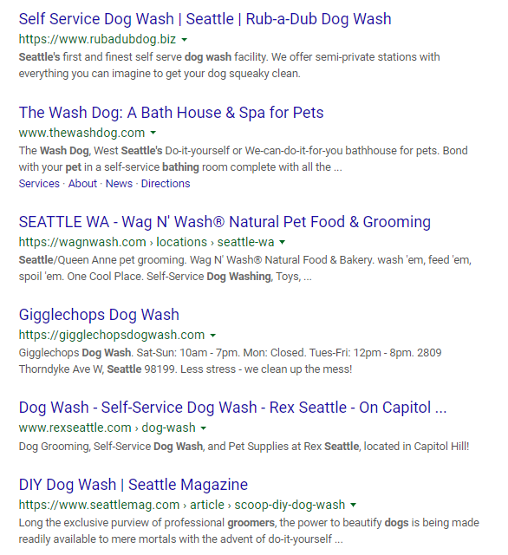
COMPETITIVE RESEARCH
To get your company name out there, you need to make sure your promote

Slide 4
COMPETITIVE RESEARCH DEEP DIVE
BACKLINKS
Use ahrefs, Moz, Alexa, etc..
On-Page SEO
Titles, Meta Descriptions, Keyword Percentages, Landing Pages
Social Media
Ratings, platforms, frequency of use

Slide 5
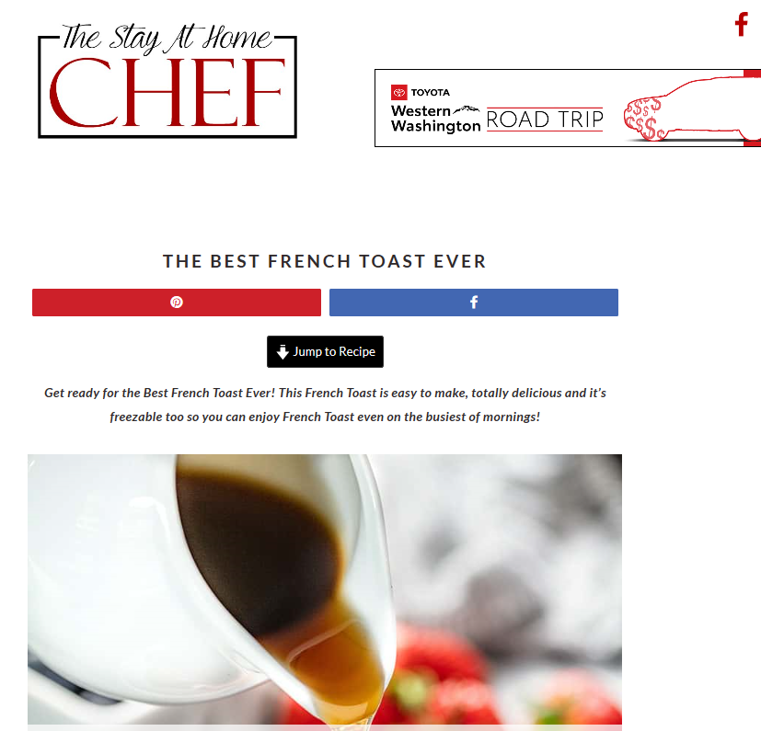
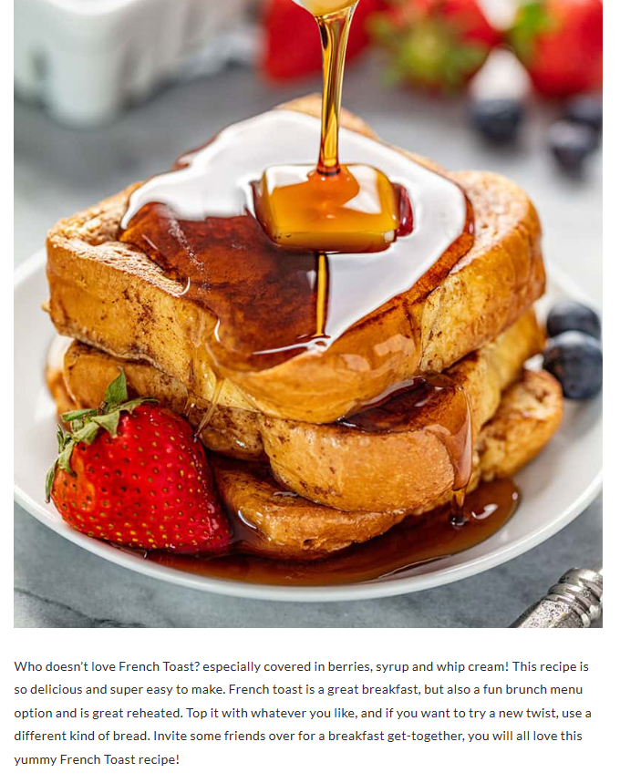
SEO WEB DESIGN PRINCIPLES
DOWN A RABBIT HOLE

Slide 6
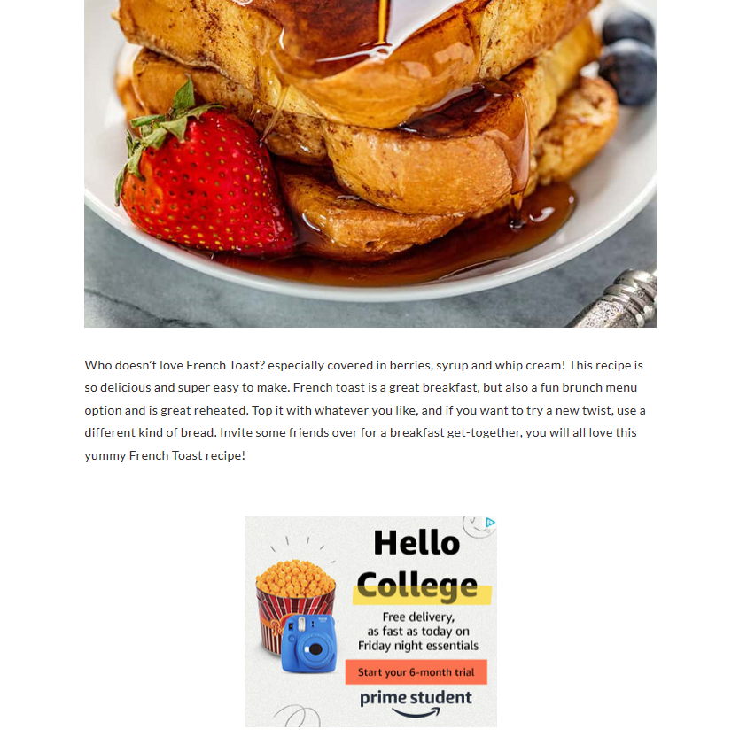
SEO WEB DESIGN PRINCIPLES
DOWN A RABBIT HOLE

Slide 7
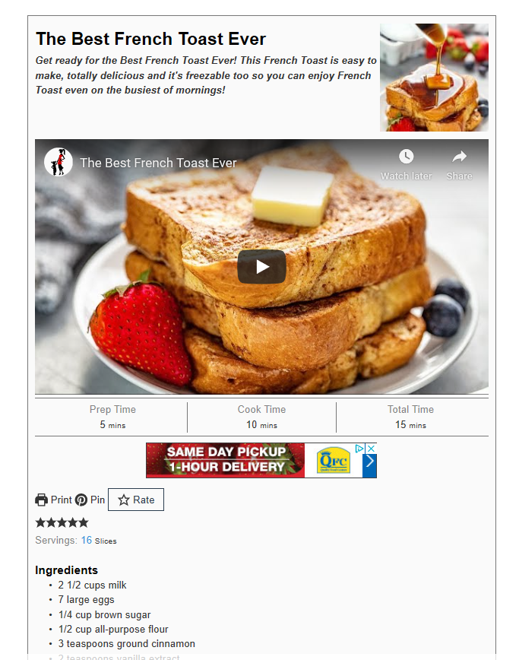
SEO WEB DESIGN PRINCIPLES
DOWN A RABBIT HOLE

Slide 8
Dog Washing Seattle
Dog Wash
Pet Groomers
Pet Supply
Pet Bathing
Wag n Wash
Dog Nail Trim
Dog Daycare
Mobile Dog Wash
Keywords

Slide 9
OUTSIDE THE BOX

Slide 10
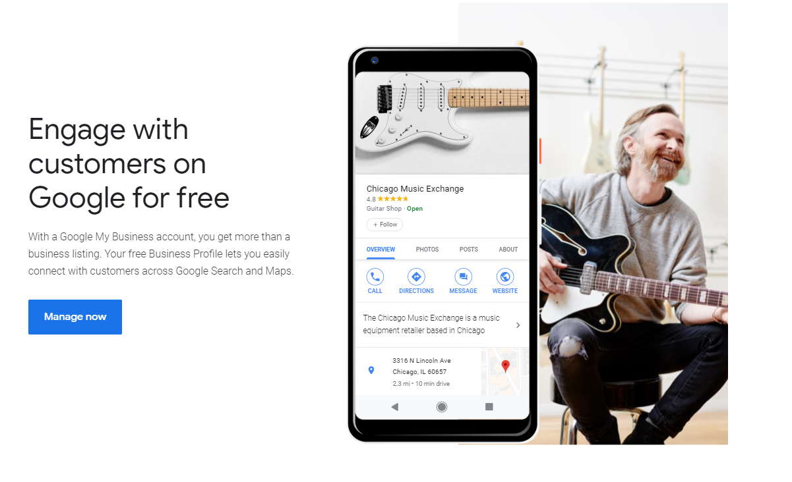
GOOGLE
MY BUSINESS
OPTIMIZE EVERYTHING

Slide 11
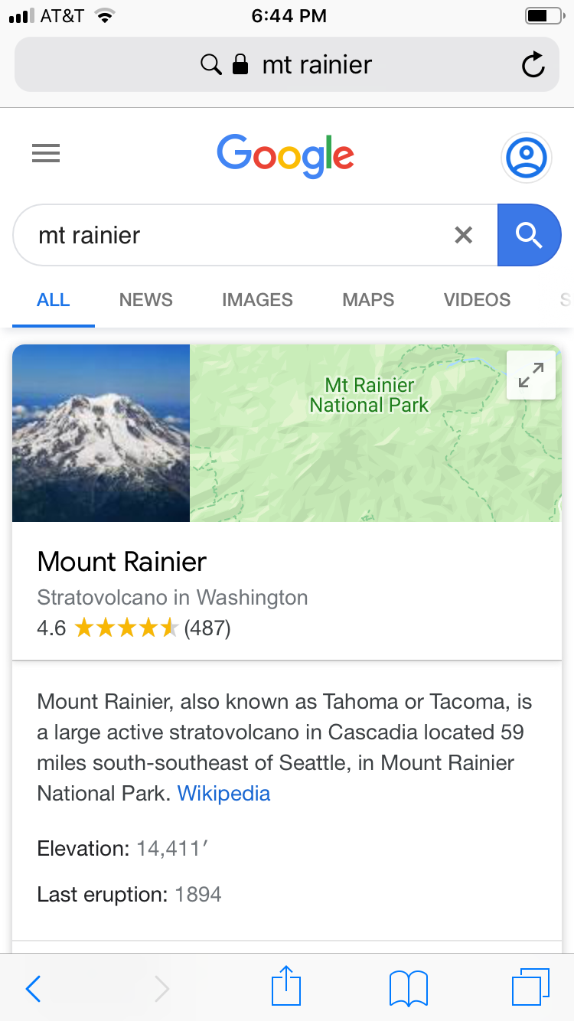
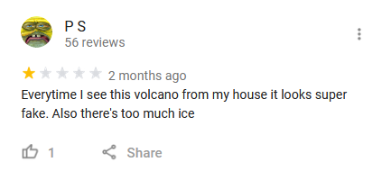
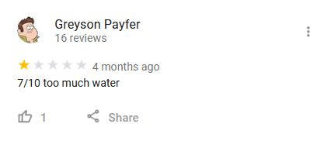
GOOGLE
MY BUSINESS

Slide 12
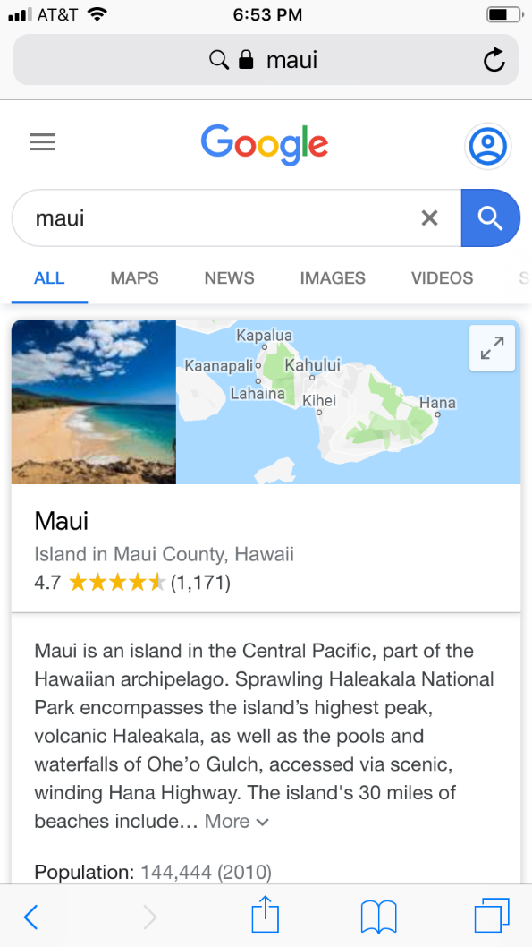
GOOGLE
MY BUSINESS

Slide 13
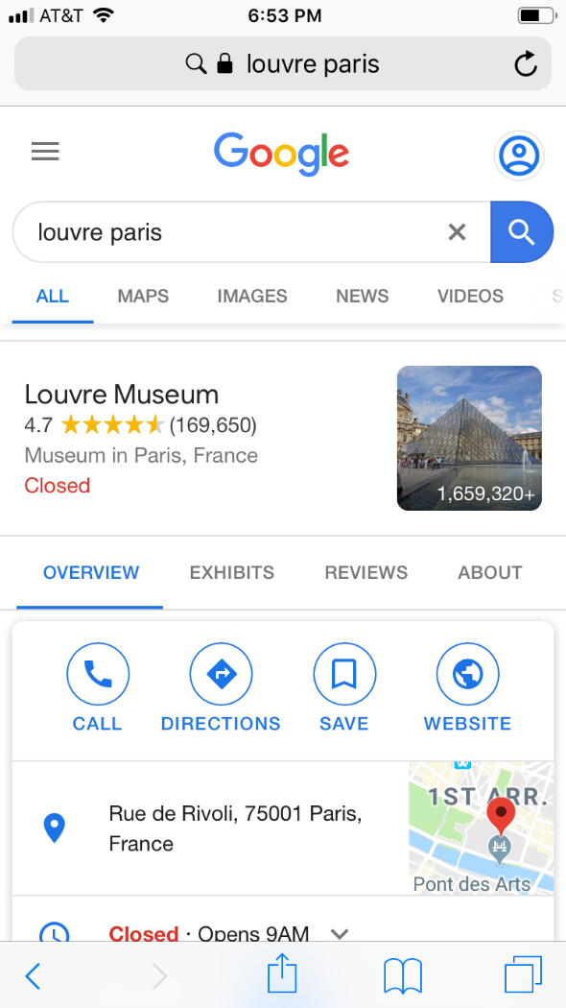
GOOGLE
MY BUSINESS

Slide 14
THANK YOU
Greg Collins

